Slide 1
Lab 5 Rooms in a House

Slide 2
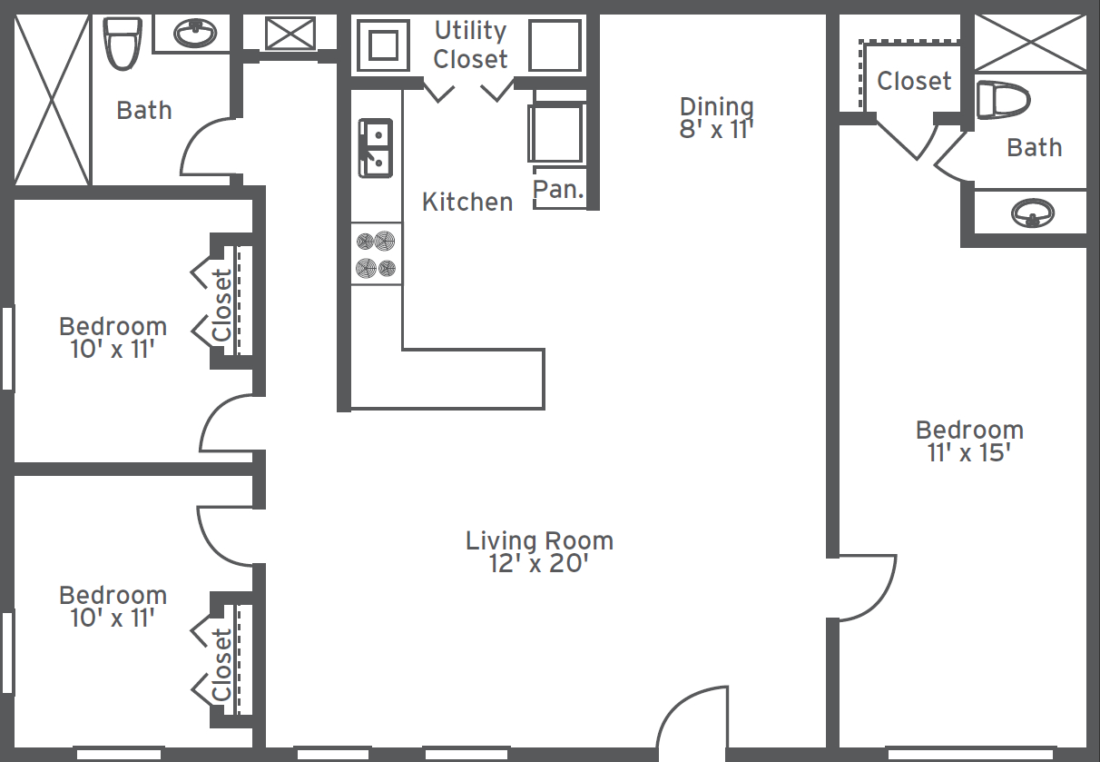
Sample Program Output
Enter the number of rooms in the house: 3
Enter room 1 information
Enter room type (sitting room, bedroom, kitchen, balcony): bedroom
Enter room width: 4
Enter room height: 5
Enter room 2 information
Enter room type (sitting room, bedroom, kitchen, balcony): sitting room
Enter room width: 6
Enter room height: 7
Enter room 3 information
Enter room type (sitting room, bedroom, kitchen, balcony): kitchen
Enter room width: 2
Enter room height: 5
House Information
[roomType=bedroom, width=4, height=5, area=20]
[roomType=sitting room, width=6, height=7, area=42]
[roomType=kitchen, width=2, height=5, area=10]
House Total Area: 72

Slide 3
House Class
A house contains many rooms
You have two classes: House and Room
House stores rooms in a Room array (see the UML diagram)
House constructor should create an empty room array
You can add a room to the house array location by using: house.rooms[i] = myRoom where myRoom is an arbitrary room.
Rooms have
Room type: Bedroom, sitting room, kitchen etc.
Room width
Room height

Slide 4
UML Diagrams
Room
-roomType: String -width: int
-height: int
Room type (bedroom, sitting room, kitchen etc.)
Room width
Room height
+Room(roomType: String)
+toString(): String
// getter and setter methods
Constructor
Returns room information as a string: [roomType=bedroom, width=4, height=5, area=20]
House
+numberOfRooms: int
+rooms: Room[]
Number of rooms in the house
Array to store room objects
+House(numberOfRooms: int)
+calculateArea(): int
+printHouse(): void
Constructor
Calculates the total area of the house. Total area is the sum of all rooms’ areas.
Prints all house information (see sample output)

Slide 5
Sample Main Code
public static void main(String[] args) {
Scanner input = new Scanner(System.in);
System.out.print("Enter the number of rooms in the house: ");
// get the number of rooms
House house = . . . // create a house
for ( each room ) {
// get room type, width, and height from the user
// add the room to the house
}
house.printHouse();
}

